Slide 1
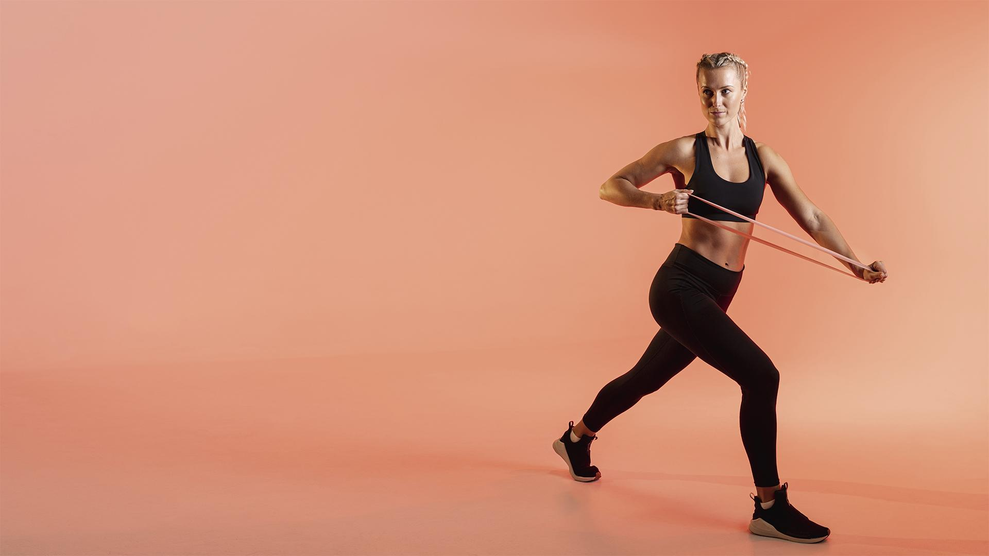
FITT

Slide 2
OUR TEAM
BIBASH THAPA MAGAR
RAJAN ARYAL
SANKET ADHIKARI

Slide 3
TABLE OF CONTENTS
01
INTRODUCTION
02
OBJECTIVES
03
IMPLICATION
04
LITERATURE REVIEW
05
TOOLS & METHODOLOGY
06
TIMLINE CHART
07
WIREFRAMES

Slide 4
01
INTRODUCTION

Slide 5
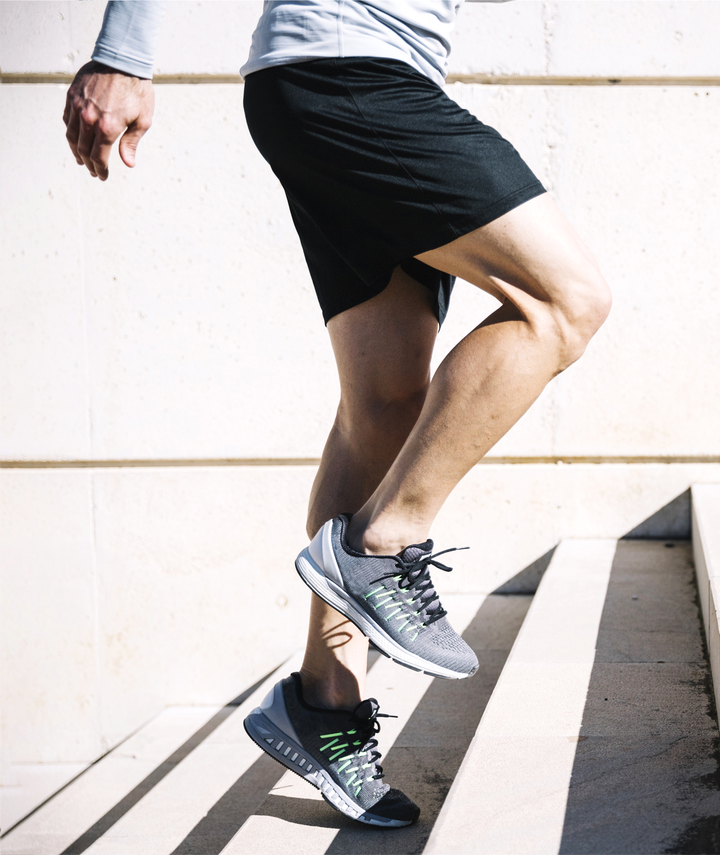
INTRODUCTION
FITT, a mobile app that brings together workout planning and is excellent for people who like a lot of guidance and instruction. The app creates a personalized program for your exercise based on whatever goal you set. You can also track your progress and activities with this app.

Slide 6
02
OBJECTIVES

Slide 7
OBJECTIVES
To provide the user with instructions and examples of one or more types of exercise, physical activity, nutritional programs, or some other fitness topic.
To keep track of the user's progress report and the basic physical parameters of the user's body.

Slide 8
03
IMPLICATION

Slide 9
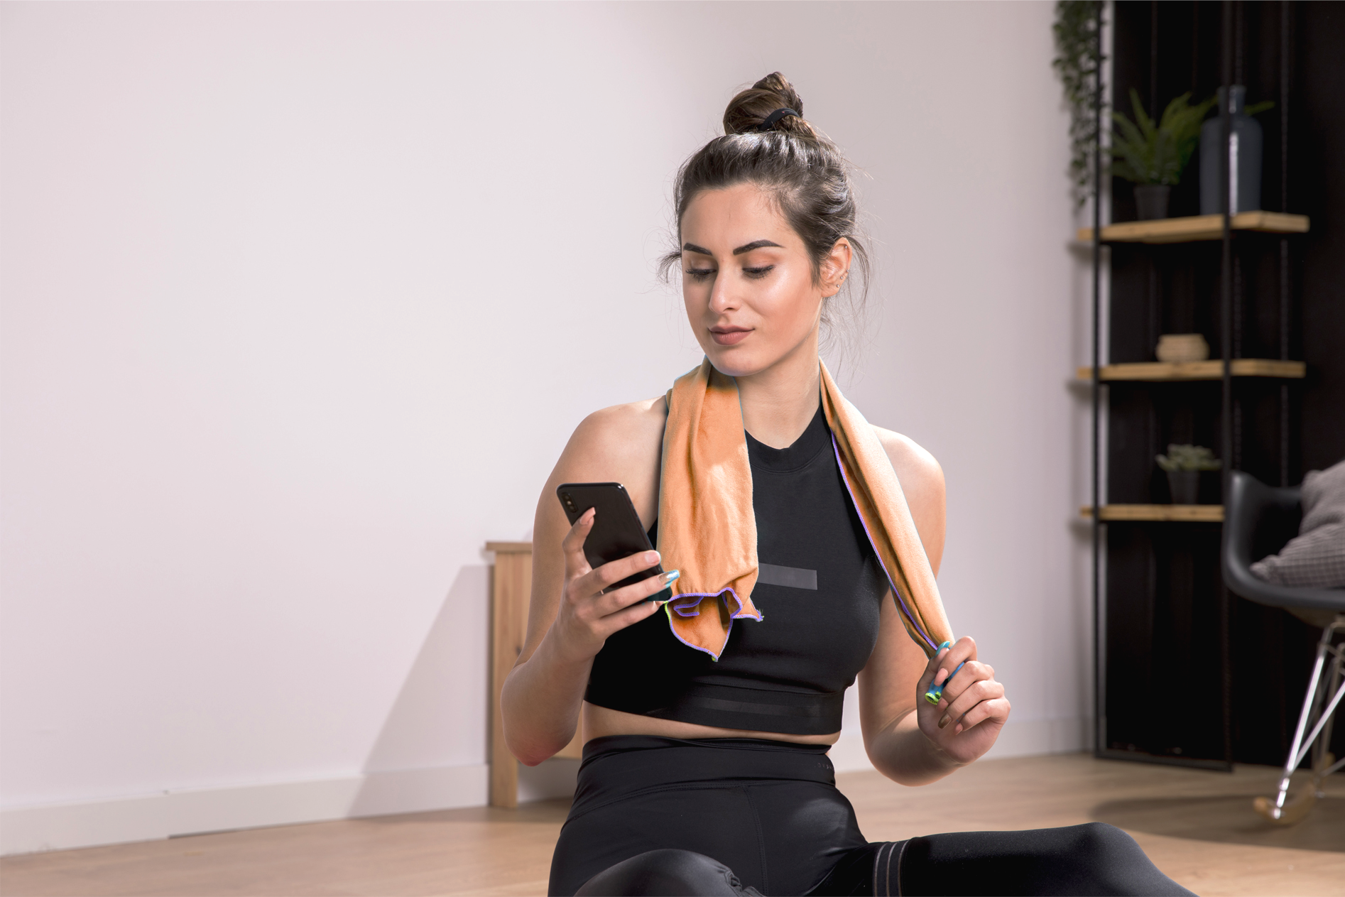
IMPLICATION
USING THE APP!
This app can be used by any type of people who are interested in fitness and the well-being of their health. Also, this app will provide a proper workout routine and track their progress. So, this site solves the ultimate problem faced by the users during their fitness lifestyle by providing proper workout plans and reports based on their past data.

Slide 10
04
LITERATURE REVIEW

Slide 11
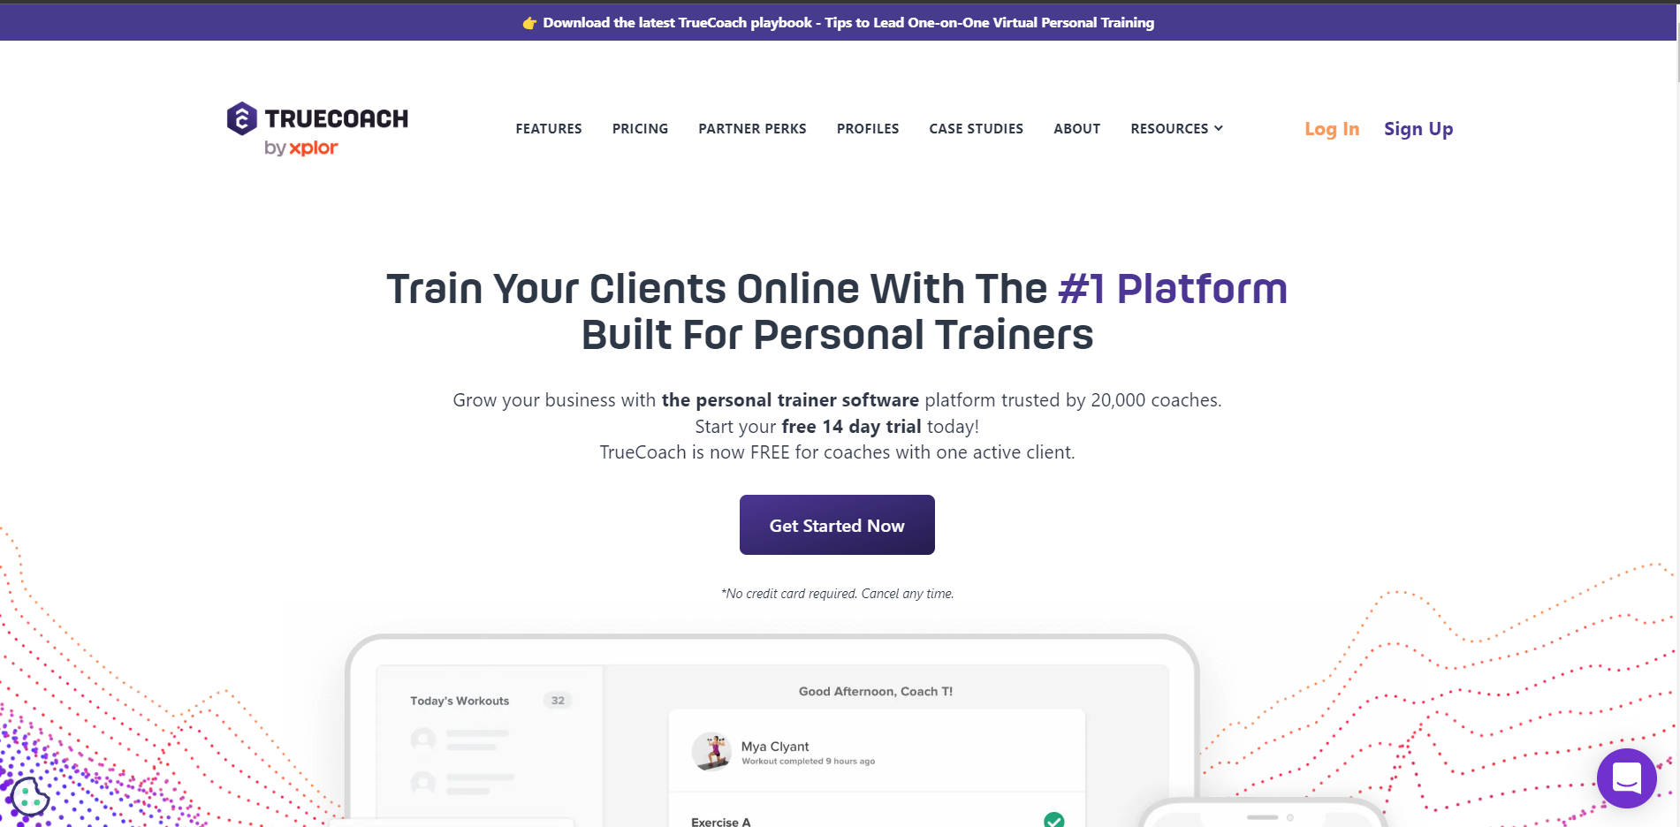
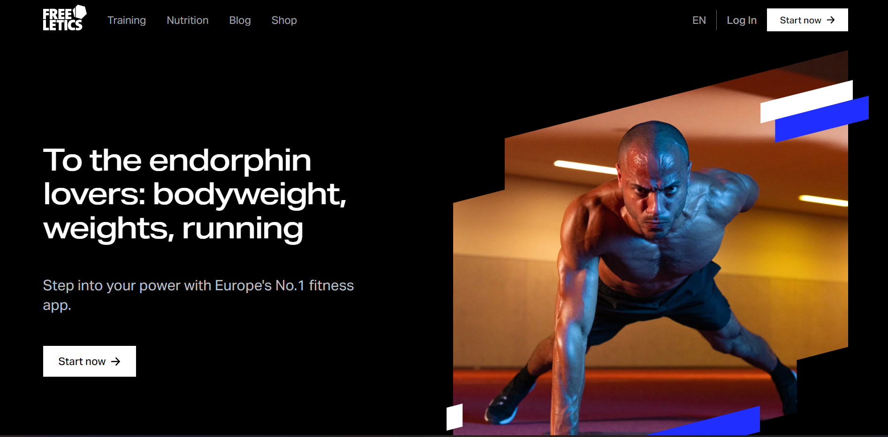
TRUECOACH
FREELETICS
TrueCoach is on a mission to help coaches save time, deliver a better experience for their clients, and grow their training businesses.
Freeletics helps working out anytime, anywhere with the best digital personal trainer - no gym required.

Slide 12
05
TOOLS & METHODOLOGY

Slide 13
TOOLS & METHODOLOGY
FRONTEND
1
2
BACKEND
Flutter
NodeJS
3
4
DESIGN
DATABASE
MongoDB
Figma, Excel, Draw.io
5
OTHERS
Git, VS Code

Slide 14
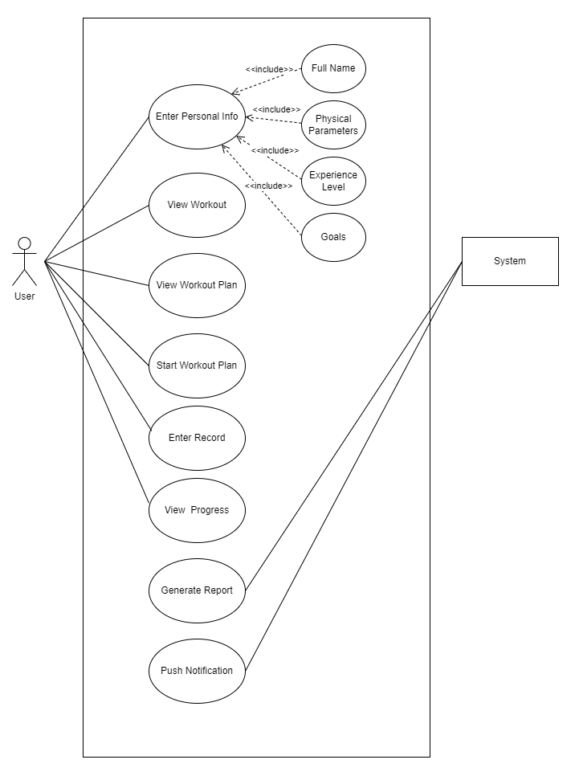
Use Case Diagram

Slide 15
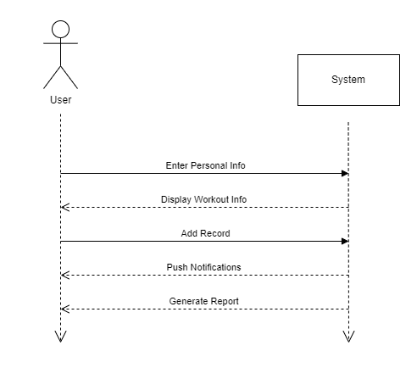
System Sequence Diagram

Slide 16
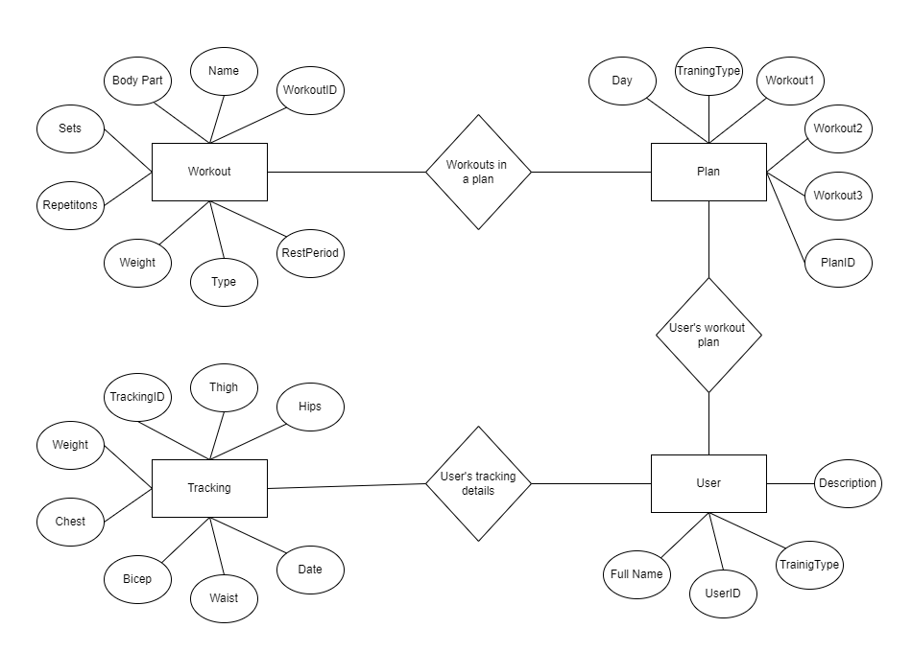
Entity Relationship Diagram

Slide 17
06
TIMELINE CHART

Slide 18
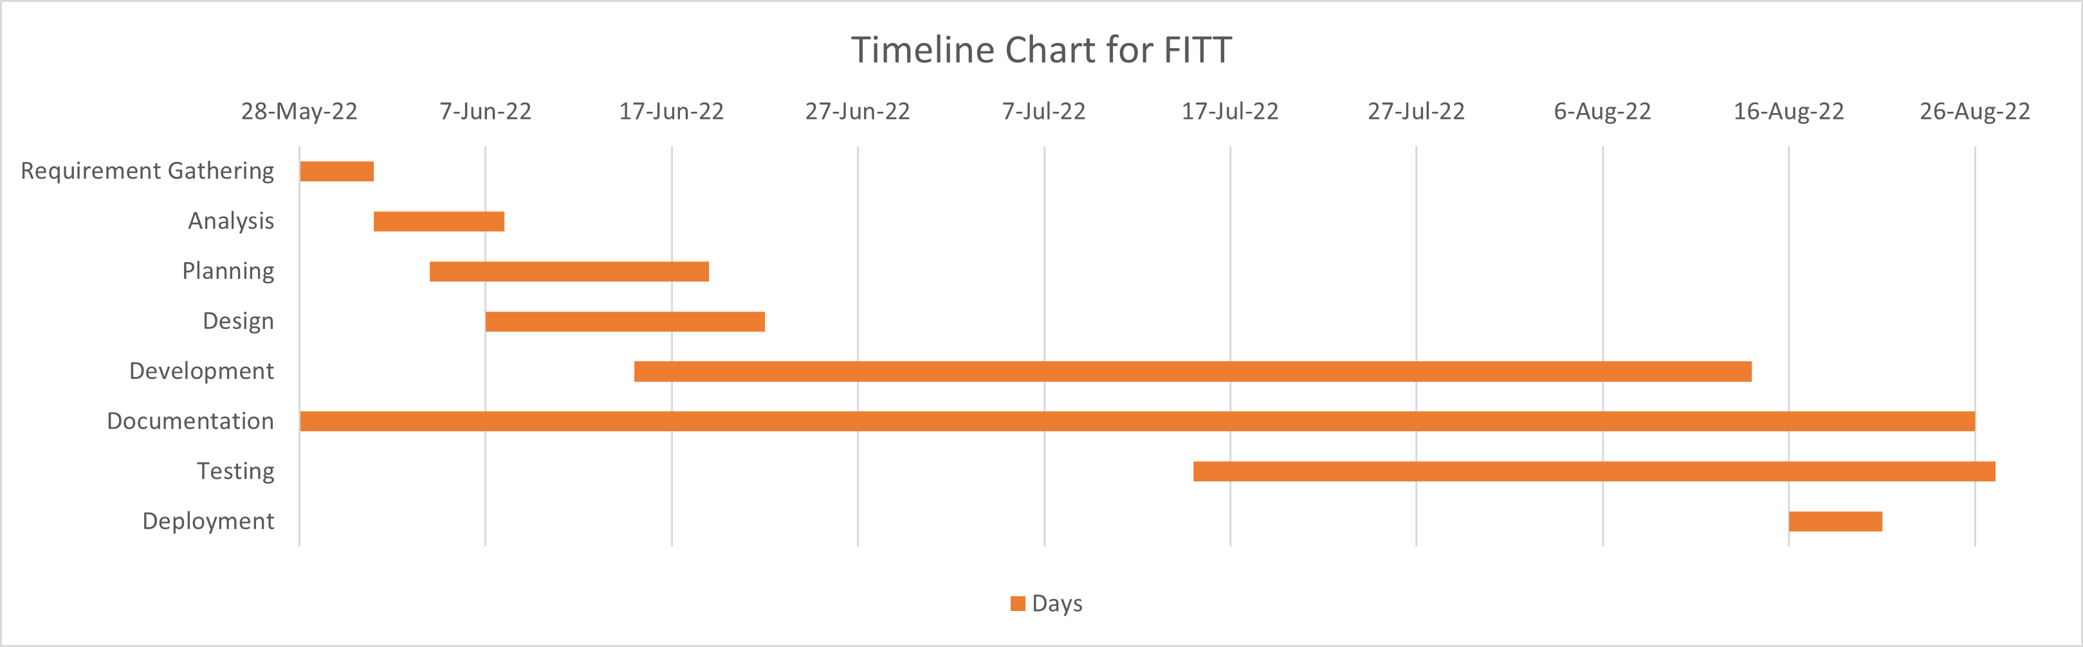
Timeline Chart

Slide 19
07
WIREFRAMES

Slide 20







Slide 21





Slide 22
THANKS!
Do you have any questions?

